Slide 1


Course Title: Operating Systems
Course Code: CS321
Assiut University
كلية معتمدة من الهيئة القومية
لضمان جودة التعليم والاعتماد
Prof. Khaled F. Hussain

Slide 2
Reference
Silberschatz, Abraham, Peter B. Galvin, and Greg Gagne. Operating system concepts. John Wiley & Sons.

Slide 3
Introduction
An operating system is a program that manages a computer’s hardware.
The purpose of an operating system is to provide an environment in which a user can execute programs in a convenient and efficient manner.
Operating systems are designed to be convenient and efficient

Slide 4
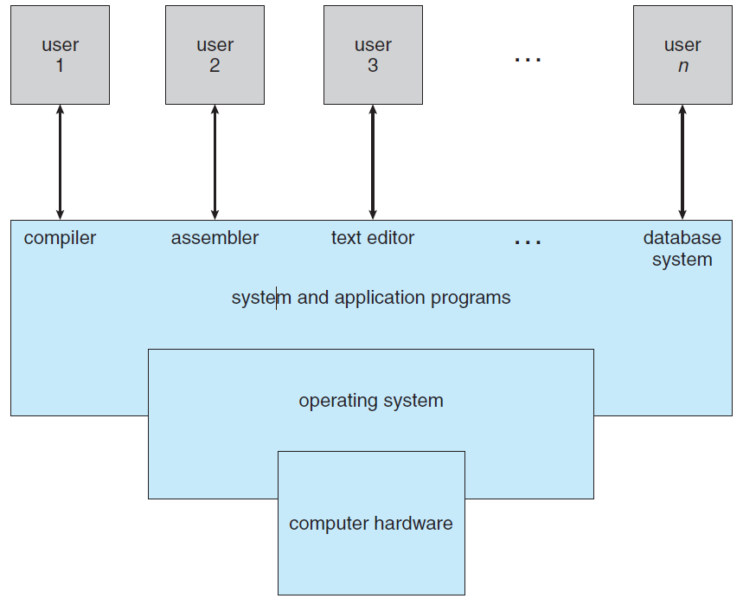
Abstract view of the components of a computer system

Slide 5
What Operating Systems Do
To understand more fully the operating system’s role, we next explore operating systems from two viewpoints: that of the user and that of the system.
User View
  The operating system is designed mostly for ease of use, with some attention paid to performance and none paid to resource utilization
System View
  We can view an operating system as a resource allocator.
  A computer system has many resources that may be required to solve a problem: CPU time, memory space, file-storage space, I/O devices, and so on. The operating system acts as the manager of these resources.

Slide 6
Bootstrap program
For a computer to start running—for instance, when it is powered up or rebooted—it needs to have an initial program to run. This initial program, or bootstrap program, tends to be simple. Typically, it is stored within the computer hardware in read-only memory (ROM) or electrically erasable programmable read-only memory (EEPROM), known by the general term firmware.
It initializes all aspects of the system, from CPU registers to device controllers to memory contents. The bootstrap program must know how to load the operating system and how to start executing that system.

Slide 7
Interrupt
The occurrence of an event is usually signaled by an interrupt from either the hardware or the software.
  Hardware may trigger an interrupt at any time by sending a signal to the CPU, usually by way of the system bus.
  Software may trigger an interrupt by executing a special operation called a system call (also called a monitor call).
When the CPU is interrupted, it stops what it is doing and immediately transfers execution to a fixed location. The fixed location usually contains the starting address where the service routine for the interrupt is located.
Interrupt vector, of addresses is indexed by a unique device number, given with the interrupt request, to provide the address of the interrupt service routine for the interrupting device.

Slide 8
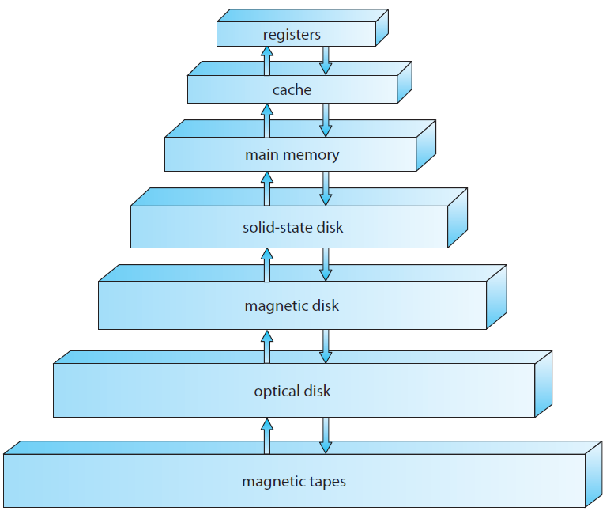
Storage-device hierarchy

Slide 9
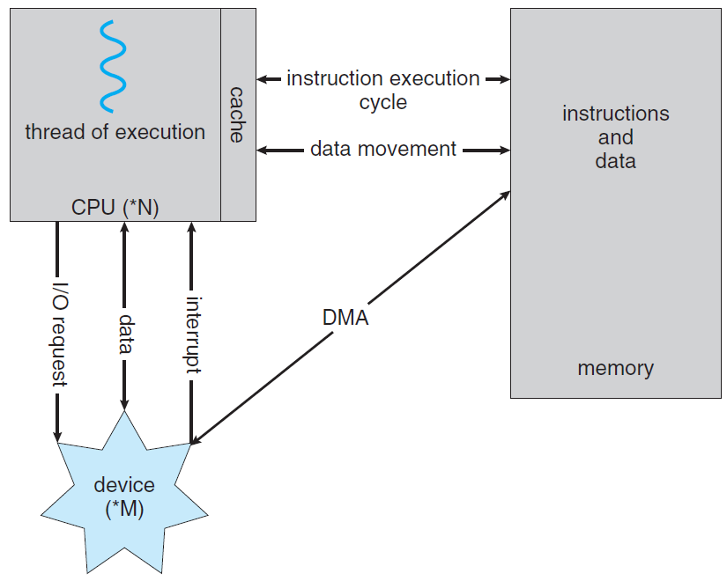
Direct memory access (DMA)

Slide 10
Dual-Mode and Multimode Operation
At the very least, we need two separate modes of operation: user mode and kernel mode (also called supervisor mode, system mode, or privileged mode).
A bit, called the mode bit, is added to the hardware of the computer to indicate the current mode: kernel (0) or user (1). With the mode bit, we can distinguish between a task that is executed on behalf of the operating system and one that is executed on behalf of the user.
When the computer system is executing on behalf of a user application, the system is in user mode. However, when a user application requests a service from the operating system (via a system call), the system must transition from user to kernel mode to fulfil the request.
If an attempt is made to execute a privileged instruction in user mode, the hardware does not execute the instruction but rather treats it as illegal and traps it to the operating system.

Slide 11
Process Management
We emphasize that a program by itself is not a process. A program is a passive entity, like the contents of a file stored on disk, whereas a process is an active entity.
The operating system is responsible for the following activities in connection with process management:
  Scheduling processes and threads on the CPUs
  Creating and deleting both user and system processes
  Suspending and resuming processes
  Providing mechanisms for process synchronization
  Providing mechanisms for process communication

Slide 12
Memory Management
Main memory is a large array of bytes, ranging in size from hundreds of thousands to billions. Each byte has its own address. Main memory is a repository of quickly accessible data shared by the CPU and I/O devices.
The operating system is responsible for the following activities in connection with memory management:
  Keeping track of which parts of memory are currently being used and who is using them
  Deciding which processes (or parts of processes) and data to move into and out of memory
  Allocating and deallocating memory space as needed

Slide 13
Storage Management
File-System Management: The operating system is responsible for the following activities in connection with file management:
  Creating and deleting files
  Creating and deleting directories to organize files
  Supporting primitives for manipulating files and directories
  Mapping files onto secondary storage
  Backing up files on stable (nonvolatile) storage media
Mass-Storage Management: The operating system is responsible for the following activities in connection with disk management
  Free-space management
  Storage allocation
  Disk scheduling
Because secondary storage is used frequently, it must be used efficiently. The entire speed of operation of a computer may hinge on the speeds of the disk subsystem and the algorithms that manipulate that subsystem.

Slide 14
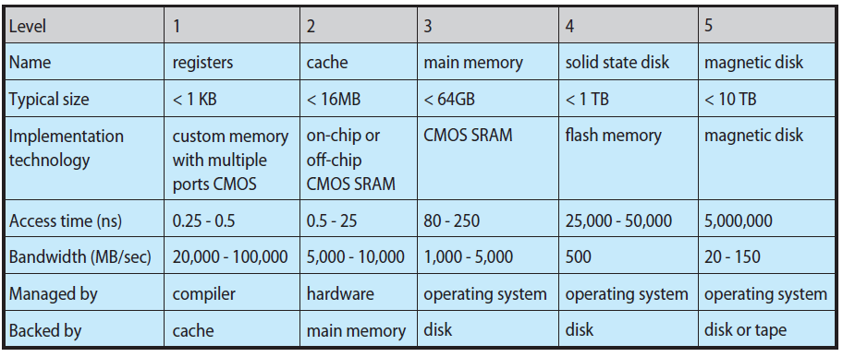
Caching

Slide 15
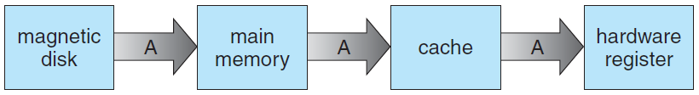
Cache coherency
In a hierarchical storage structure, the same data may appear in different levels of the storage system.
For example, suppose that an integer A that is to be incremented by 1 is located in file B, and file B resides on magnetic disk. The increment operation proceeds by first issuing an I/O operation to copy the disk block on which A resides to main memory. This operation is followed by copying A to the cache and to an internal register. Thus, the copy of A appears in several places: on the magnetic disk, in main memory, in the cache, and in an internal register.

Slide 16
I/O Systems
The I/O subsystem consists of several components:
  A general device-driver interface
  Drivers for specific hardware devices
  A memory-management component that includes buffering, caching, and spooling

Slide 17
Protection and Security

Slide 18
Virtualization
Virtualization is a technology that allows operating systems to run as applications within other operating systems.
  allow an entire operating system written for one platform to run on another.
Emulation is used when the source CPU type is different from the target CPU type. For example, when Apple switched from the IBM Power CPU to the Intel x86 CPU for its desktop and laptop computers, it included an emulation facility called “Rosetta,” which allowed applications compiled for the IBM CPU to run on the Intel CPU.
  Emulation comes at a heavy price, the emulated code can run much slower than the native code.

Slide 19
Cloud Computing
Cloud computing is a type of computing that delivers computing, storage, and even applications as a service across a network.
  For example, the Amazon Elastic Compute Cloud facility has thousands of servers, millions of virtual machines, and petabytes of storage available for use by anyone on the Internet.
There are actually many types of cloud computing, including the following:
  Public cloud—a cloud available via the Internet to anyone willing to pay for the services
  Private cloud—a cloud run by a company for that company’s own use
  Hybrid cloud—a cloud that includes both public and private cloud components
  Software as a service (SaaS)—one or more applications (such as word processors or spreadsheets) available via the Internet
  Platform as a service (PaaS)—a software stack ready for application use via the Internet (for example, a database server)
  Infrastructure as a service (IaaS)—servers or storage available over the Internet (for example, storage available for making backup copies of production data)

Slide 20
Real-Time Embedded Systems
Embedded computers are the most prevalent form of computers in existence. These devices are found everywhere, from car engines and manufacturing robots to DVDs and microwave ovens.
Embedded systems almost always run real-time operating systems. A real-time system is used when rigid time requirements have been placed on the operation of a processor or the flow of data.
A real-time system has well-defined, fixed time constraints. Processing must be done within the defined constraints, or the system will fail.

Slide 21
Open-Source Operating Systems
Open-source operating systems are those available in source-code format rather than as compiled binary code. Linux is the most famous opensource operating system.
Microsoft Windows is a well-known example of the closed-source approach.
Apple’s Mac OS X and iOS operating systems comprise a hybrid approach. They contain an open-source kernel named Darwin yet include proprietary, closed-source components as well.

